Slide 1
Chapter 6 notes

Slide 2
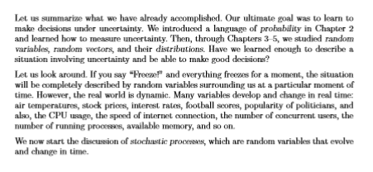
Introduction

Slide 3
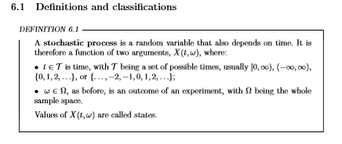

Slide 4
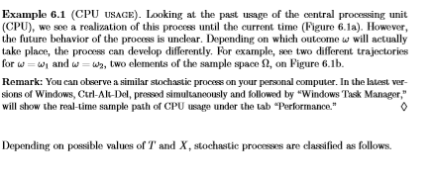
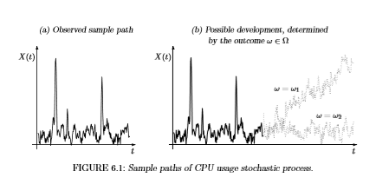

Slide 5
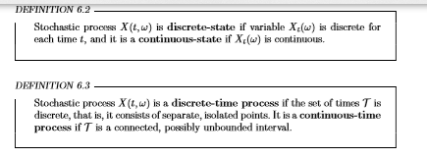

Slide 6
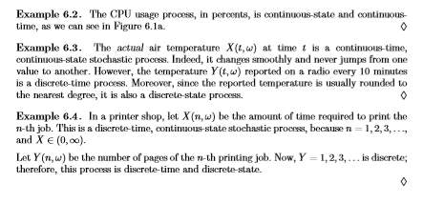

Slide 7
Bayesian Applications
Although Bayes’ rule is credited to Thomas Bayes, Bayesian applications were ﬁrst introduced by French scientist Pierre Simon Laplace, who published a paper on using Bayesian inference on the unknown binomial proportions (for binomial distribution, see Section 5.2).
Since the introduction of the Markov chain Monte Carlo (MCMC) computational tools for Bayesian analysis in the early 1990s, Bayesian statistics has become more and more popular in statistical modeling and data analysis.
Meanwhile, methodology developments using Bayesian concepts have progressed dramatically, and they are applied in ﬁelds such as bioinformatics, biology, business, engineering, environmental and ecology science, life science and health, medicine, and many others.
Source: Walpole Book (page 710)

Slide 8
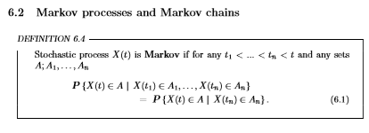
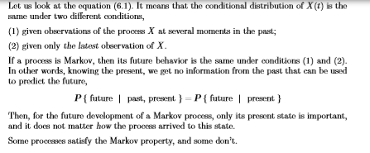

Slide 9
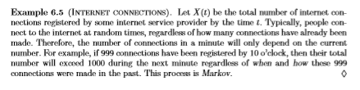

Slide 10
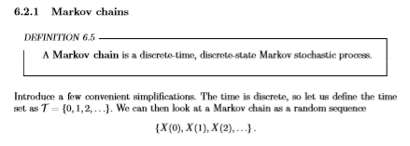

Slide 11
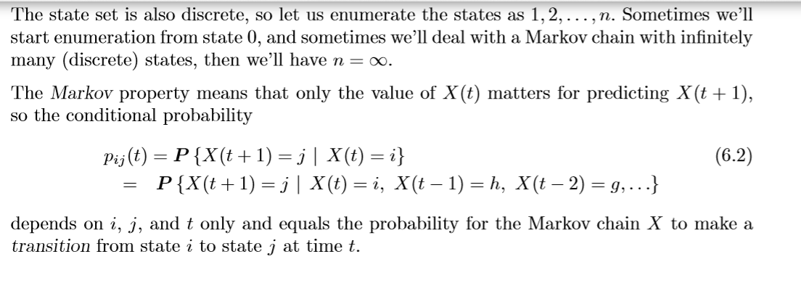

Slide 12
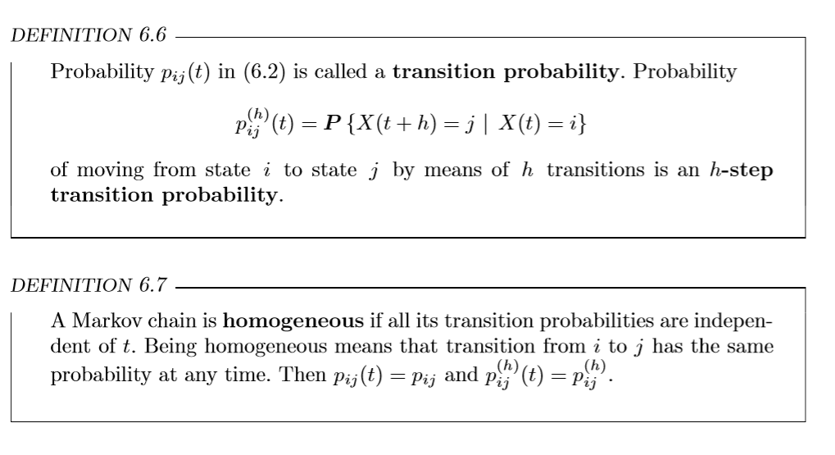

Slide 13
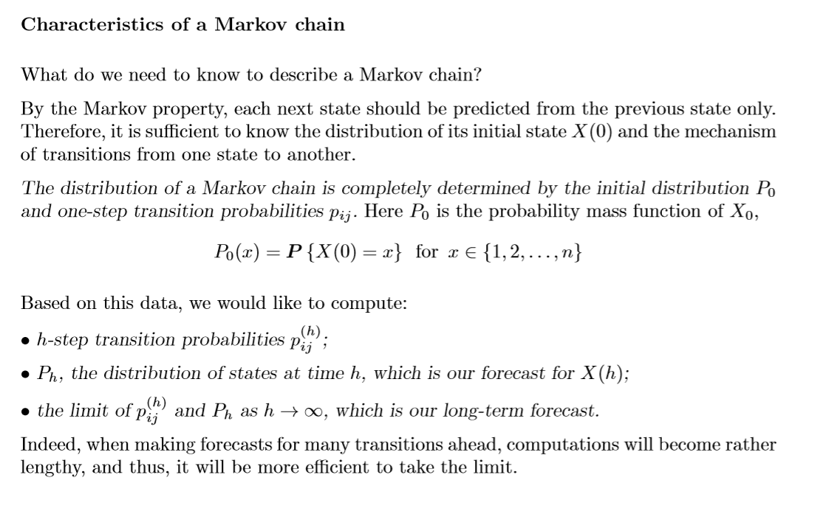

Slide 14
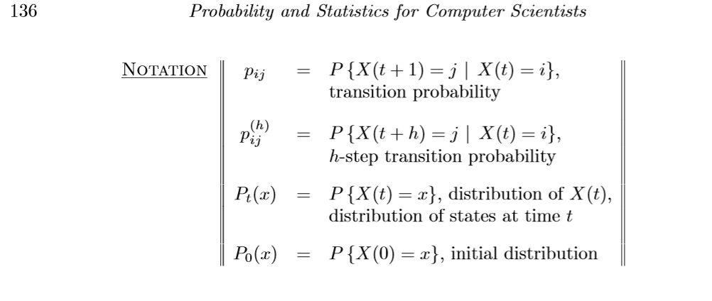

Slide 15
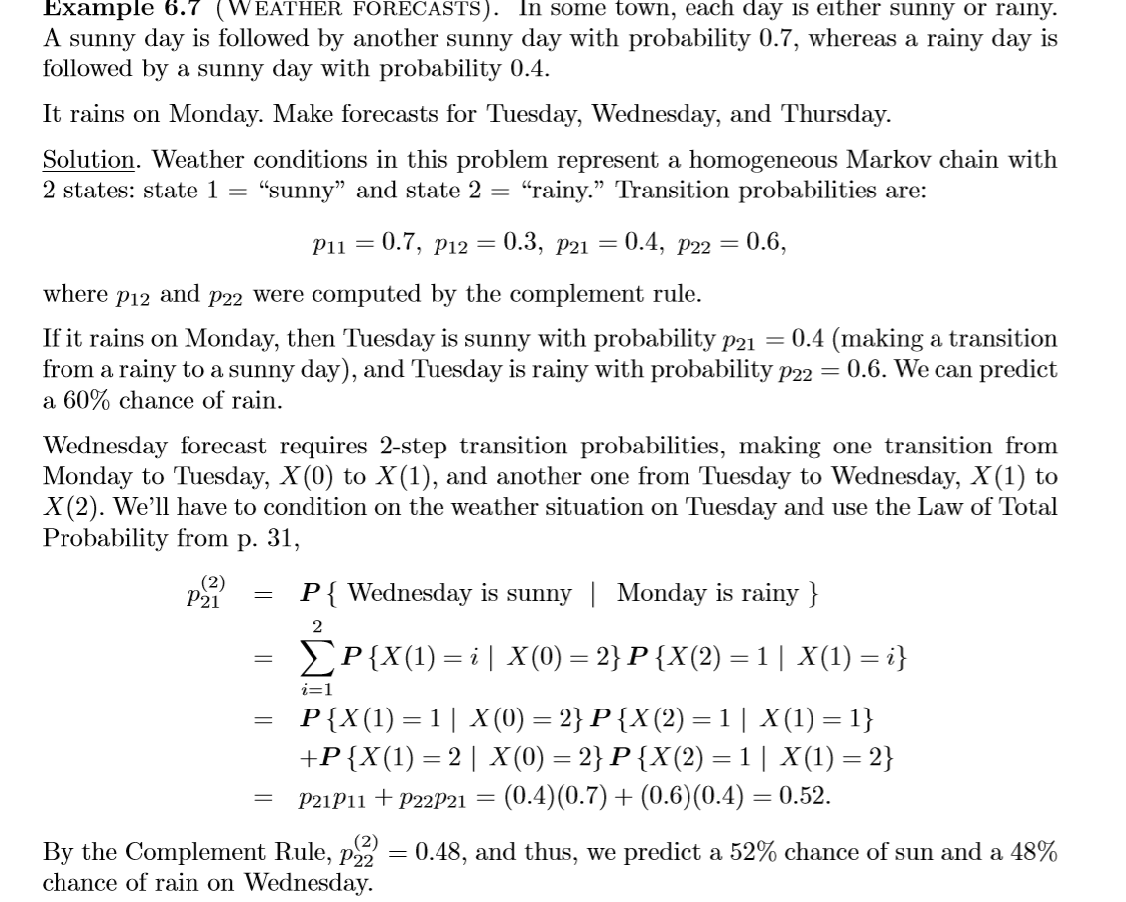

Slide 16
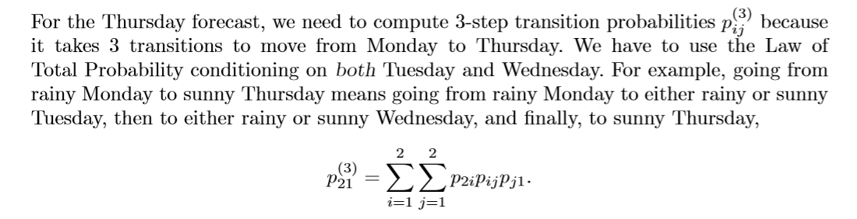

Slide 17
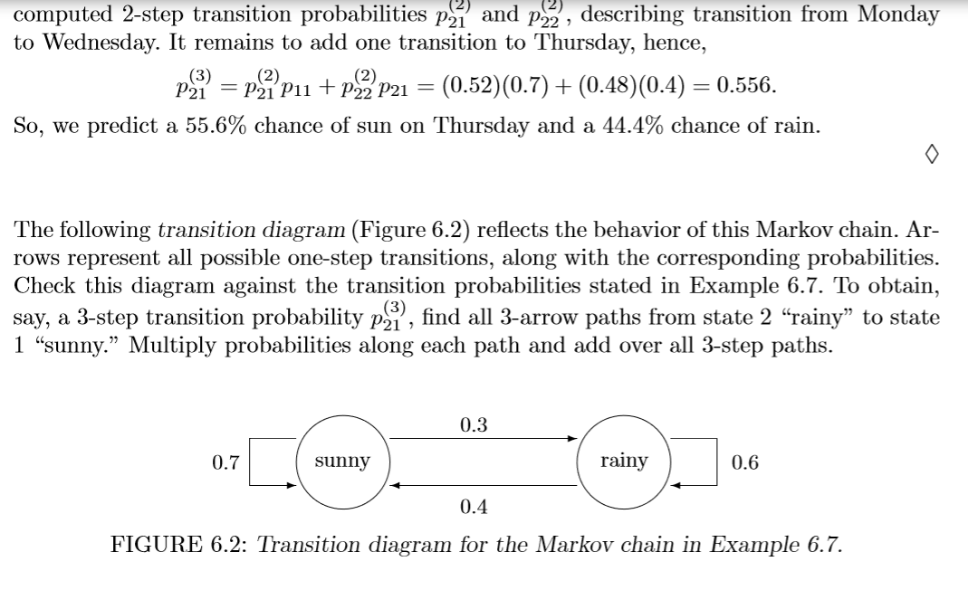

Slide 18
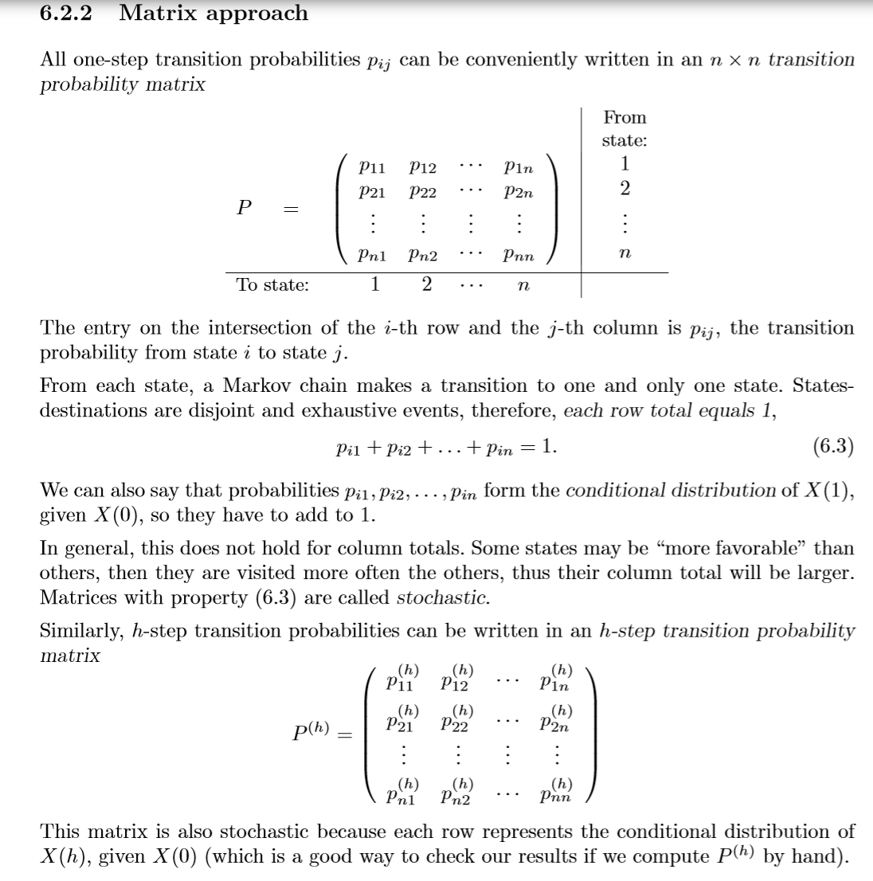

Slide 19
